Slide 1


Lecture 2: Q-Learning
Dr. MALKI Abdelhamid @: a.malki@esi-sba.dz
Ecole Supérieure d’Informatique de Sidi Bel Abbes (ESI-SBA) 2024/2025
Module IASD: Advanced Deep Learning (ADL)

Slide 2
What is RL? recap
In RL, we build an agent that can make smart decisions.
To make intelligent decisions, our agent will learn from the environment by interacting with it through trial and error and receiving rewards (positive or negative) as unique feedback.
Our goal is to find an optimal policy π* , aka., a policy that leads to the best expected cumulative reward.

Slide 3
What is RL? recap
Almost all RL problems can be formalized as Markov Decision Process MDP.
An MDP(S, A, T_{a}, R_{a}, γ ) is defined by:
Set of states S, as a set of all possible states.
Set of actions A, as a set of all possible actions.
Transition function T_{a}(s’ | s, a), as a state transition probabilities.
Reward function R(s, a, s’), as rewarding mapping from state s, action a, next state s’ tuple to reward.
Discount factor 𝛾, ∈ [0,1], a real number determining importance of future rewards for control objective.

Slide 4
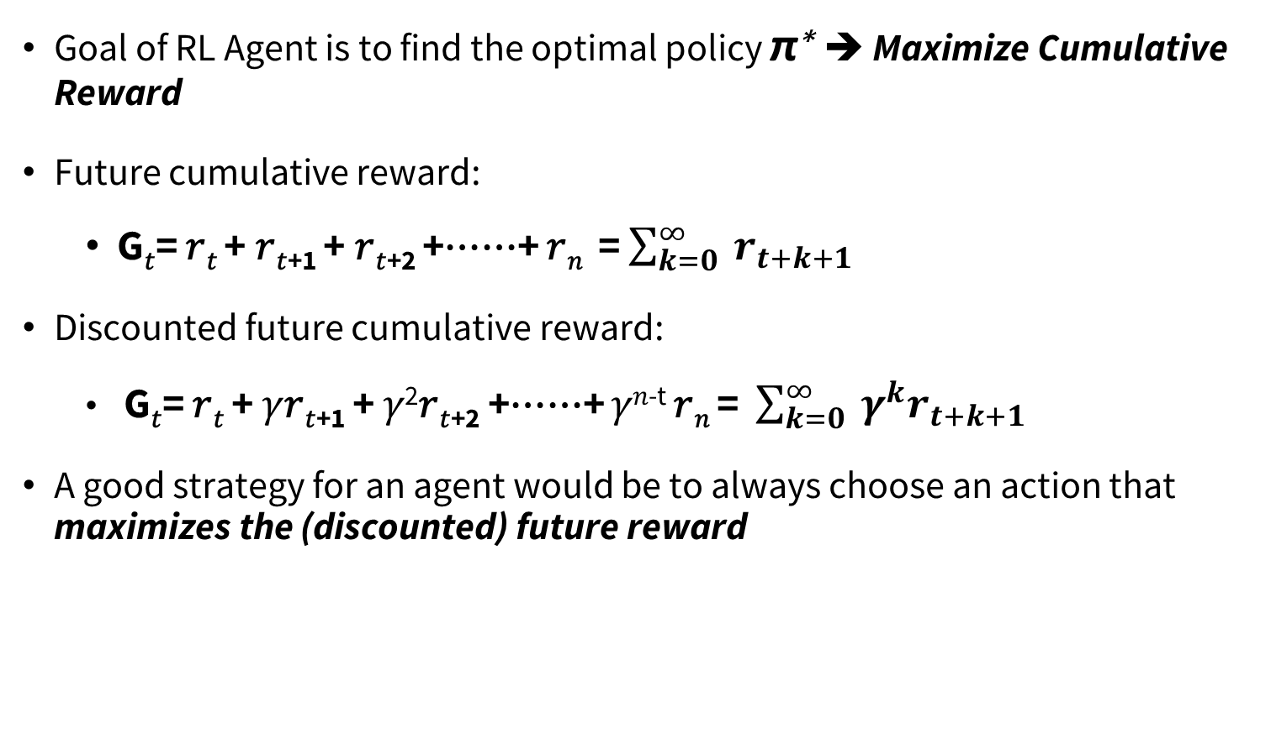
What is RL? recap
Goal of RL Agent is to find the optimal policy π∗ ➔ Maximize Cumulative Reward
Future cumulative reward:
G_{𝑡}= 𝑟_{𝑡} + 𝑟_{𝑡+1} + 𝑟_{𝑡+2} +⋯⋯+ 𝑟_{𝑛} = $\sum_{k=0}^{∞}{{ r}_{t+k+1}}$
Discounted future cumulative reward:
G_{𝑡}= 𝑟_{𝑡} + 𝛾𝑟_{𝑡+1} + 𝛾²𝑟_{𝑡+2} +⋯⋯+ 𝛾^{𝑛-t} 𝑟_{𝑛} = $\sum_{k=0}^{∞}{{{ γ}_{ }^{k}r}_{t+k+1}}$
A good strategy for an agent would be to always choose an action that maximizes the (discounted) future reward

Slide 5
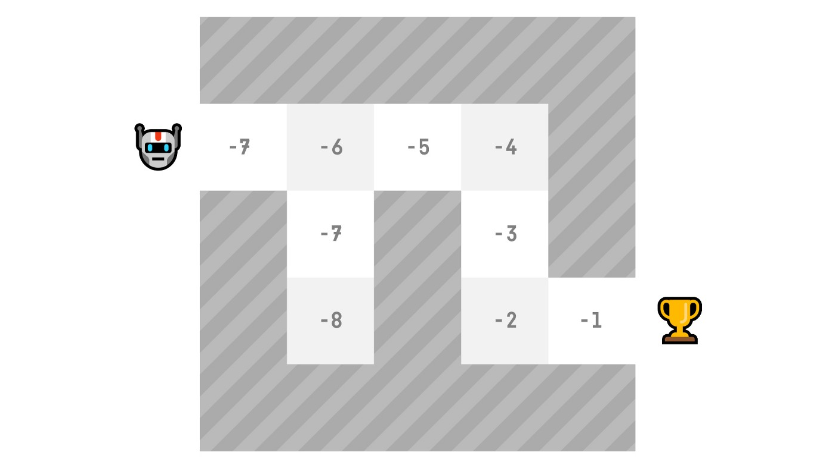
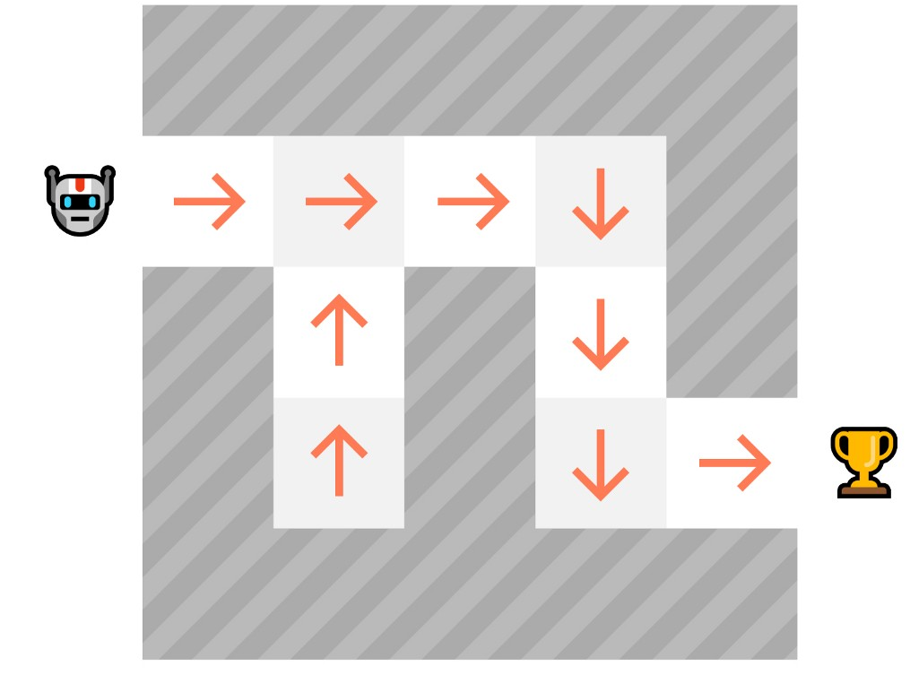
What is RL? recap
To find this optimal policy π∗ (hence solving the RL problem), there are two main types of RL methods:
Value-based methods: Train a value function to learn which state is more valuable and use this value function to take the action that leads to it.
Policy-based methods: Train the policy directly to learn which action to take given a state.

Slide 6
Value function
In value-based training, finding an optimal value function (denoted V* or Q*) leads to having an optimal policy.
We have two types of value-based functions:
state-value function V_{π}(s)
action-value function Q_{π}(s,a):

Slide 7
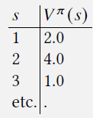

state-value function V_{π}(s)
state-value function V_{π}(s) : 𝑉 : 𝑆 $→$ ℝ
How good is a state?
The state-value function gives the expected cumulative reward G_{t} when starting from a specific state s and following a policy π thereafter.
Taking actions according to our policy (greedy policy)
V_{π}(s) = E_{π}[ G_{t} | S_{t} = s]
V_{π}(s) = E_{π}[𝑟_{𝑡} + 𝛾 𝑟_{𝑡+1} + 𝛾²𝑟_{𝑡+2} +⋯⋯+ 𝛾^{𝑛-t} 𝑟_{𝑛} | S_{t} = s]

Slide 8
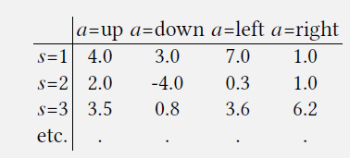

action-value function Q_{π}(s,a)
action-value function Q_{π}(s, a): Q: S x A$→$ ℝ
How good is a state-action pair?
The action-value function at state s and action a, is the expected cumulative reward G_{t} from taking action a in state s and then following the policy π.
Q_{π}(s, a) = E_{π}[ G_{t} | S_{t} = s, A_{t}=a]
Q_{π}(s, a) = E_{π}[𝑟_{𝑡} + 𝛾 𝑟_{𝑡+1} + 𝛾²𝑟_{𝑡+2} +⋯⋯+ 𝛾^{𝑛-t} 𝑟_{𝑛} | S_{t} = s, A_{t}=a]

Slide 9
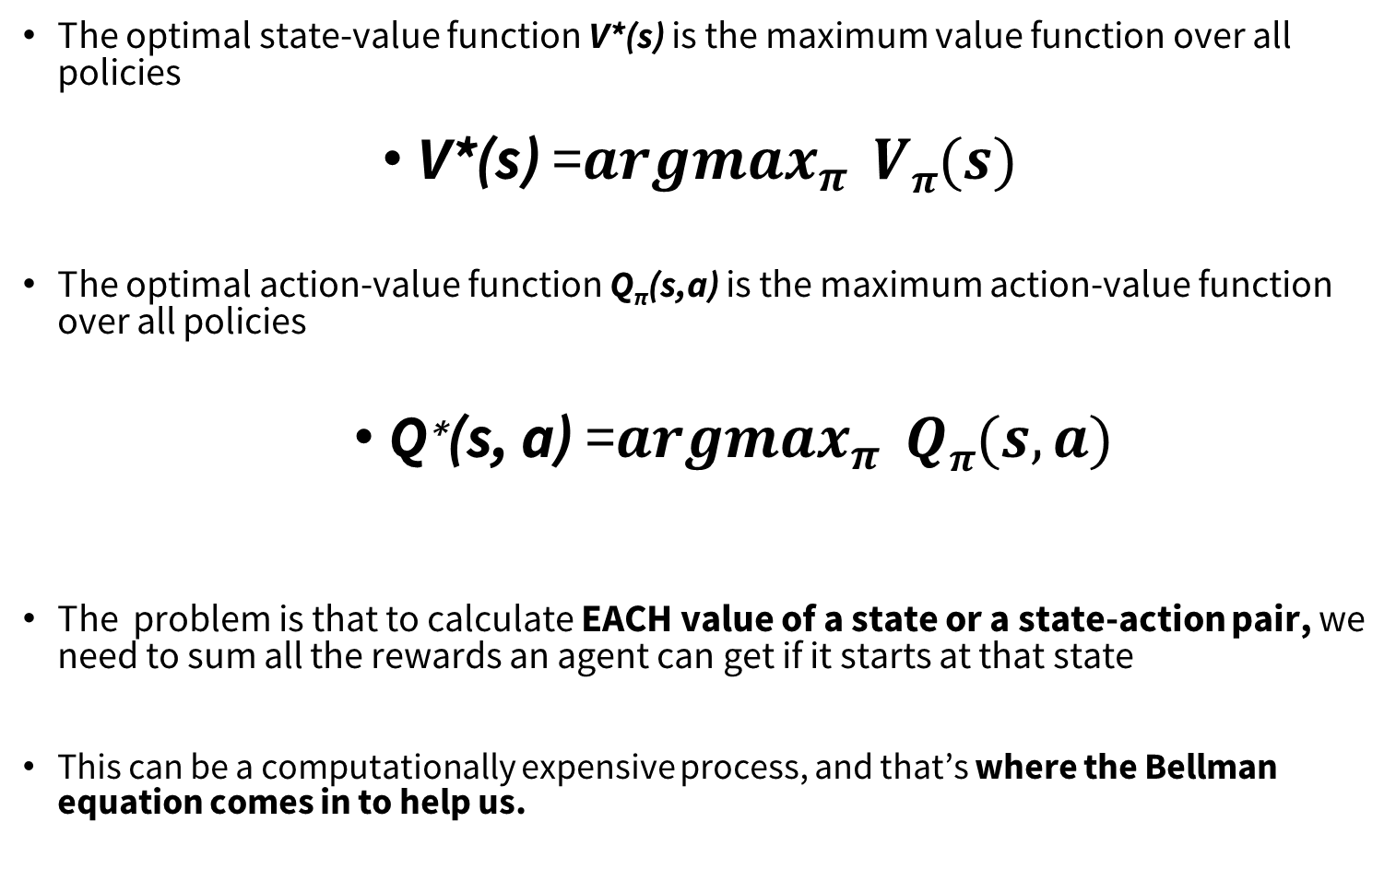
Optimal Value Function
The optimal state-value function V*(s) is the maximum value function over all policies
V*(s) =${argmax}_{π } Vπ(s)$
The optimal action-value function Q_{π}(s,a) is the maximum action-value function over all policies
$\text{Q}\text{∗}\text{(}\text{s}\text{, }\text{a}\text{)}\text{ =}{argmax}_{π } Qπ(s, a)$
The problem is that to calculate EACH value of a state or a state-action pair, we need to sum all the rewards an agent can get if it starts at that state
This can be a computationally expensive process, and that’s where the Bellman equation comes in to help us.

Slide 10
Bellman equation
The foundation of many RL algorithms is the fact that value functions satisfy a recursive relationship, called the Bellman equation.
Bellman equation decomposes the value function into two parts, the immediate reward ( 𝑟_{𝑡} ) + the discounted future values (𝛾G_{𝑡+1} ).
V_{π}(s)= E_{π}[ G_{t}= 𝑟_{𝑡} + 𝛾 𝑟_{𝑡+1} + 𝛾²𝑟_{𝑡+2} +⋯⋯+ 𝛾^{𝑛-t} 𝑟_{𝑛} | S_{t} = s]
➔ V_{π}(s)= E_{π}[𝑟_{𝑡} + 𝛾 G_{𝑡+1}| S_{t} = s]
⬄ E_{π}[𝑟_{𝑡} + 𝛾V_{π}(s_{t+1}) | S_{t} = s]
G_{t+1}

Slide 11
Bellman equation
The bellman optimality equation is the bellman equation for the optimal Value-function
V*(s) = max_{a} E_{π}[𝑟_{𝑡} + 𝛾V*(s_{t+1}) ]
The bellman optimality equation is the bellman equation for the optimal action-value function
Q*(s,a)= E _{π}[ r_{t}+ 𝛾 max_{a’} Q*(s_{t+1}, a’)]

Slide 12
How to train/update value-function policy ?
An RL agent learns by interacting with its environment. The idea is that given the experience and the received reward, the agent will update its value function or policy.
Monte Carlo , Temporal Difference Learning and Dynamic Programming , are three different strategies on how to train our value function policy.
Monte Carlo uses an entire episode of experience before learning.
Temporal Difference uses only a step (S_{t}​, A_{t​} ,R_{t+1​},S_{t+1​}) to learn.
Dynamic Programming (given transition function)

Slide 13
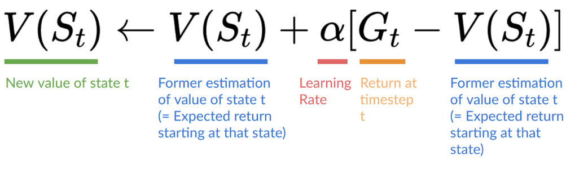
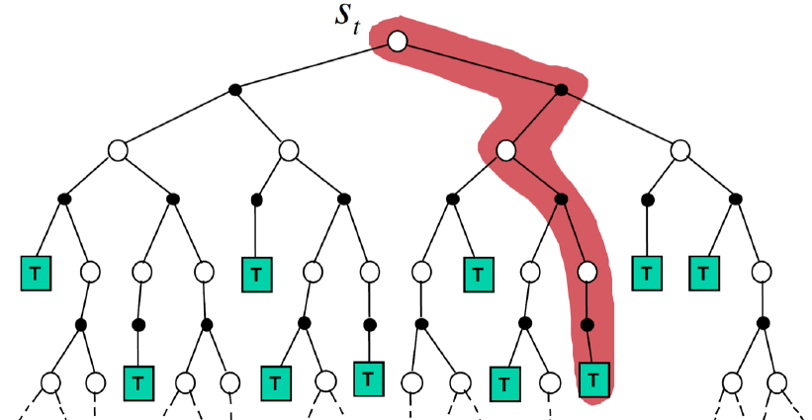
How to train/update value-function policy ?
Monte Carlo waits until the end of the episode, calculates G_{t}​ (return) and uses it as a target for updating V(S_{t}​).
So it requires a complete episode of interaction before updating our value function.

Slide 14
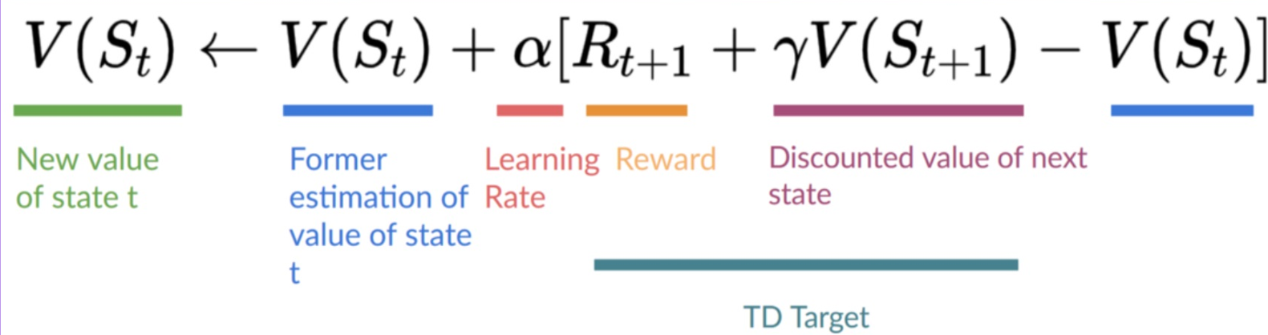
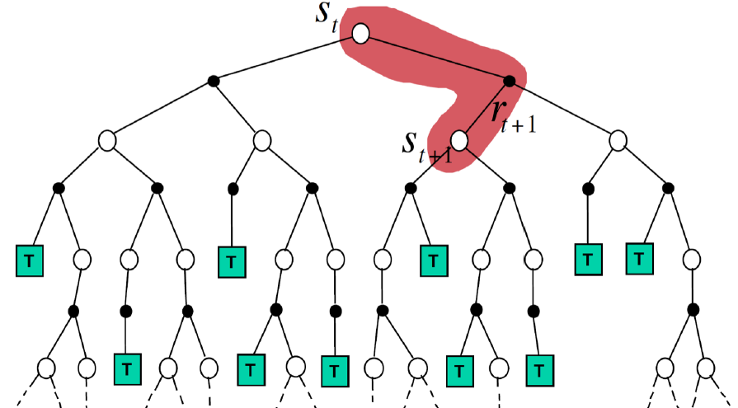
How to train/update value-function policy ?
In TD (Temporal Difference), we only look one step ahead and then estimate the rest

Slide 15
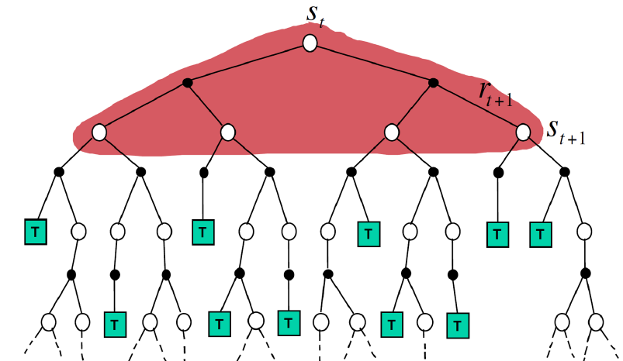
How to train/update value-function policy ?
In Dynamic programming, we used to consider all possible states one level ahead

Slide 16
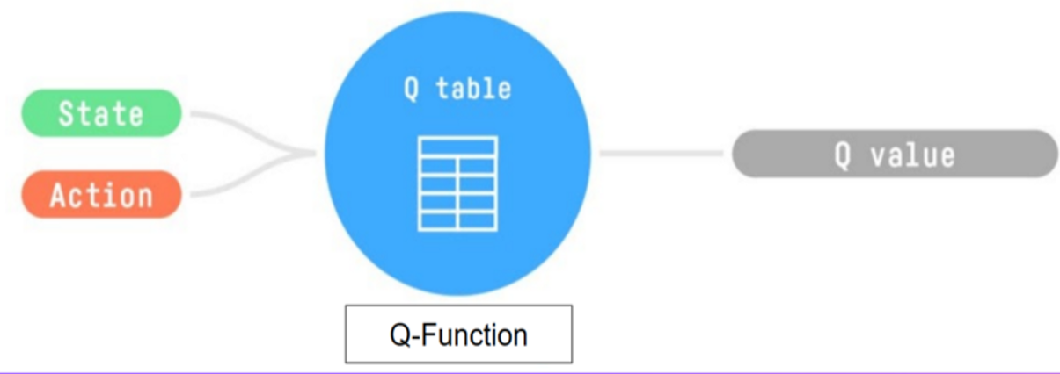
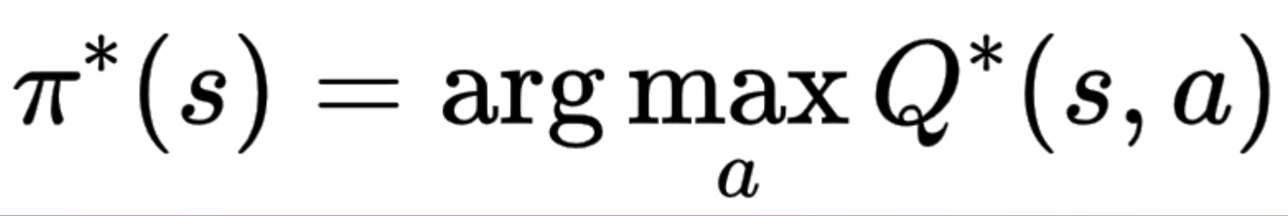
Q-Learning
Q-Learning is an off-policy, value-based RL Algorithm that uses a Temporal Difference approach to train its action-value function or Q-function Q(s,a).
Internally, the Q-function is encoded by a Q-table, a table where each cell corresponds to a state-action pair value.
When the training is done, we have an optimal Q-table ➔ optimal Q-function➔ optimal Policy
Since we know the best action to take at each state.

Slide 17
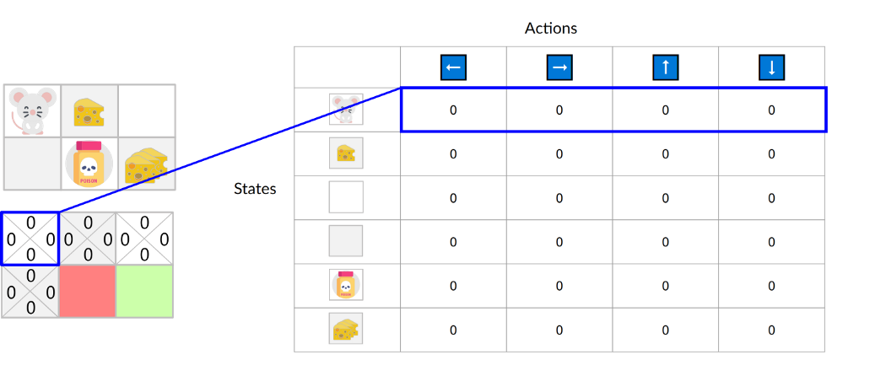
Q-Table
The Q-function is encoded by a Q-table, a table where each cell corresponds to a state-action pair value
The Q-table is initialized. That’s why all values are = 0. This table contains, for each state and action, the corresponding state-action values.

Slide 18
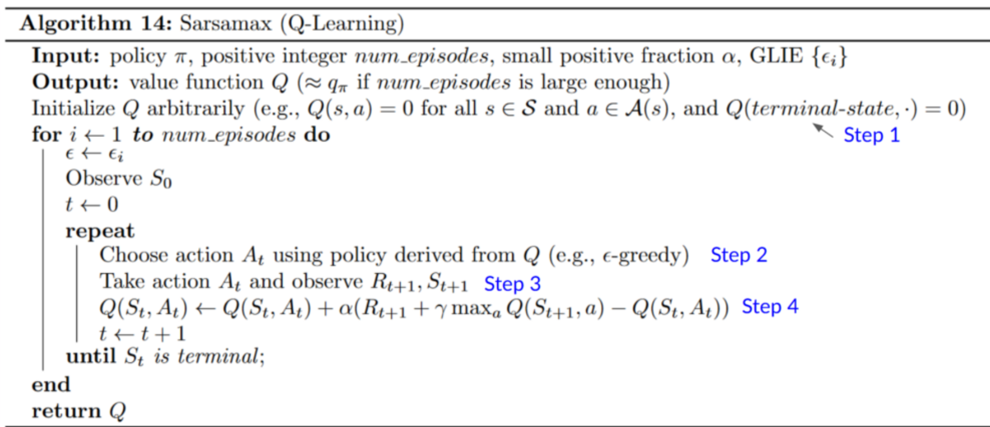
Q-Learning pseudocode

Slide 19
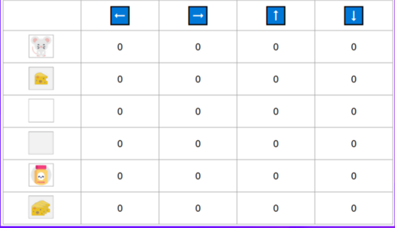
Q-learning Algo: Step 1: Q-table initialization
Step 1: We need to initialize the Q-table for each state-action pair. Most of the time, we initialize with values of 0.

Slide 20





Q-learning Algo: Step 2: Choose an action using $ε$-greedy policy
Step 2: Choose an action using the $ε$-greedy policy
Exploitation: selects the greedy action
1-$ε$
$ε$-greedy policy
$$ε$$
Exploration: selects a random action

Slide 21
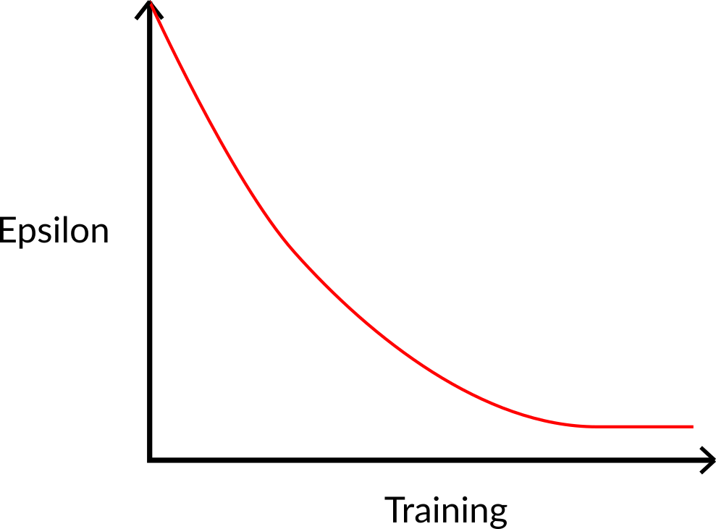

Q-learning Algo: Step 2: Choose an action using $ε$-greedy policy
The epsilon-greedy policy handles the exploration/exploitation trade-off.
The idea is that, with an initial value of ɛ = 1.0:
With probability ɛ: we do exploration (trying random action).
With probability 1 — ɛ: we do exploitation (i.e., our agent selects the action with the highest state-action pair value).
At the beginning of the training, the probability of doing exploration will be huge since ɛ is very high, so most of the time, we’ll explore.
But as the training goes on, and consequently our Q-table gets better and better in its estimations, we progressively reduce the epsilon value since we will need less exploration and more exploitation.

Slide 22
Q-learning Algo: Step 3: Perform action
Step 3: Perform action At, get reward Rt+1 and next state St+1

Slide 23
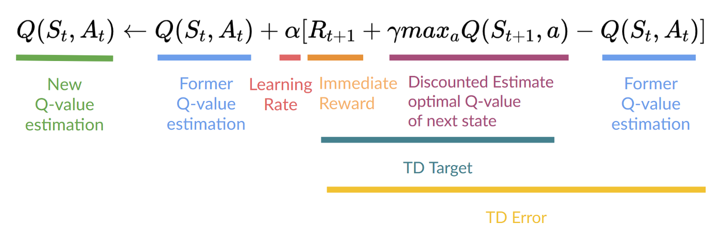
Q-learning Algo: Step 4: Update Q(St, At)
Step 4: Update Q(St, At)
Remember that in TD Learning, we update our Q-function after one step of the interaction.
To produce our TD target, we used the immediate reward R​_{t+1} plus the discounted value of the next state, computed by finding the action that maximizes the current Q-function at the next state.

Slide 24

Off-policy vs On-policy
Off-policy: using a different policy for acting (inference) and updating (training).
For instance, with Q-Learning, the epsilon-greedy policy (acting policy), is different from the greedy policy that is used to select the best next-state action value to update our Q-value (updating policy).
Is different from the policy we use during the training part:
Acting Policy
Updating Policy

Slide 25
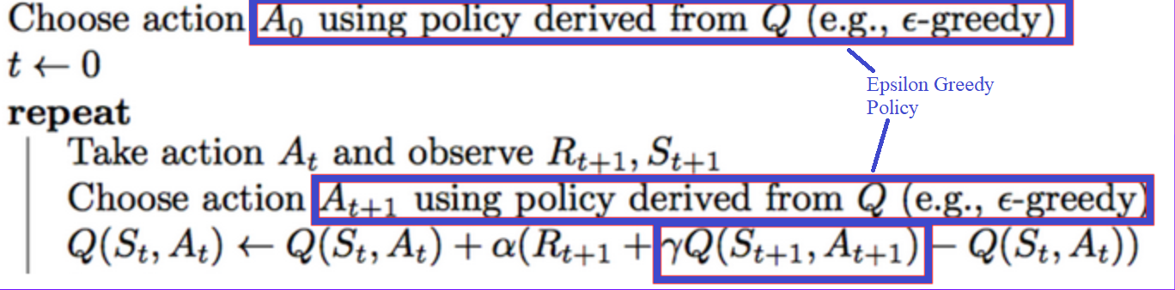
Off-policy vs On-policy
On-policy: using the same policy for acting and updating.
For instance, with Sarsa, another value-based algorithm, the epsilon-greedy policy selects the next state-action pair, not a greedy policy
Boostrapping → use estimates to make more estimates

Slide 26
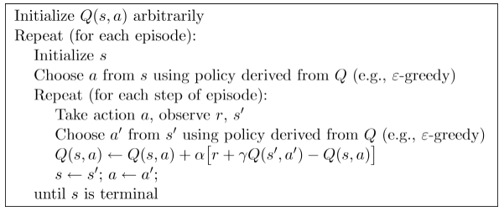
Sarsa algo: on-policy

Slide 27
REF
https://huggingface.co/learn/deep-rl-course/
https://deep-reinforcement-learning.net/
Slides for the course Reinforcement Learning (Master Computer Science 2022 at Leiden University)

